Slide 1
CMP-5045B: Embedded Systems
Demo C – WeBike by
Joshua Crafton 100254853
&
Manuel Dogbatse 100307922
Module Organizer: Edwin Ren
17 May 2022
University of East Anglia
Notes:
Section one takes about ? min.
Section two takes about ? min.

Slide 2
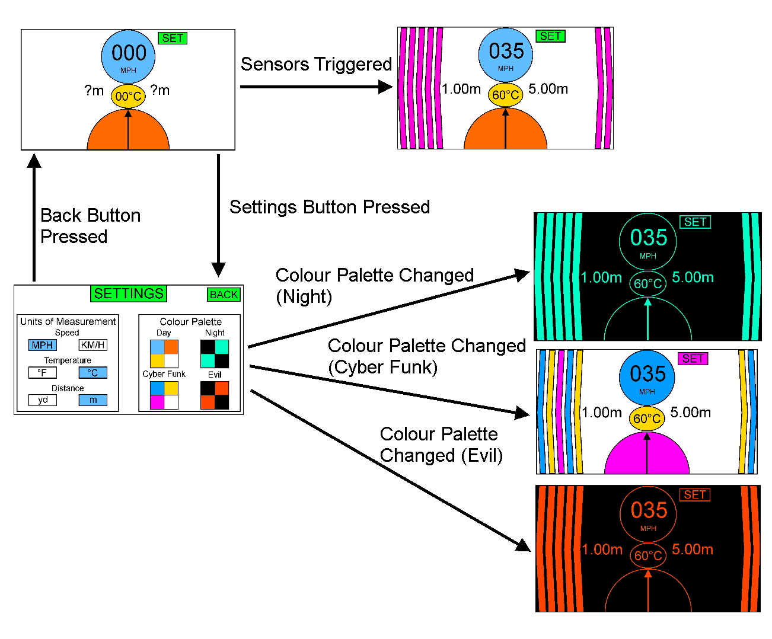
Application Scenario
Typical motorcycles aren’t very informative and are more likely to have fatal injuries in car accidents.
We have designed a RTOS system that will use sensor data to alert a driver of potential risks whilst driving.
The Device will show the distance of nearby hazards, the motorbike engine temperature and display the lean angle of the bike.

Slide 3
Hardware and Software Specification
Hardware
Stm32f7-discovery Board.
Ultrasonic Sensor
3-axis accelerometer
Software
Board Support: STM32F746G Discovery (v1.0.0)
Keil uVision5 MDK-Pro Evaluation (v5.35.0.0)
ARM::CMSIS (v5.9.0)
Keil::STM32F7xx.DFP (v2.14.1)
HC SR04
MPU 6050
Active Buzzer
LED’s
Digital Temperature Sensor
DS18B20
ARM::CMSIS-DRIVER (v2.7.1)
Keil::MDK-Middleware (v7.15.0)
Keil::ARM_Compiler (v1.72)

Slide 4
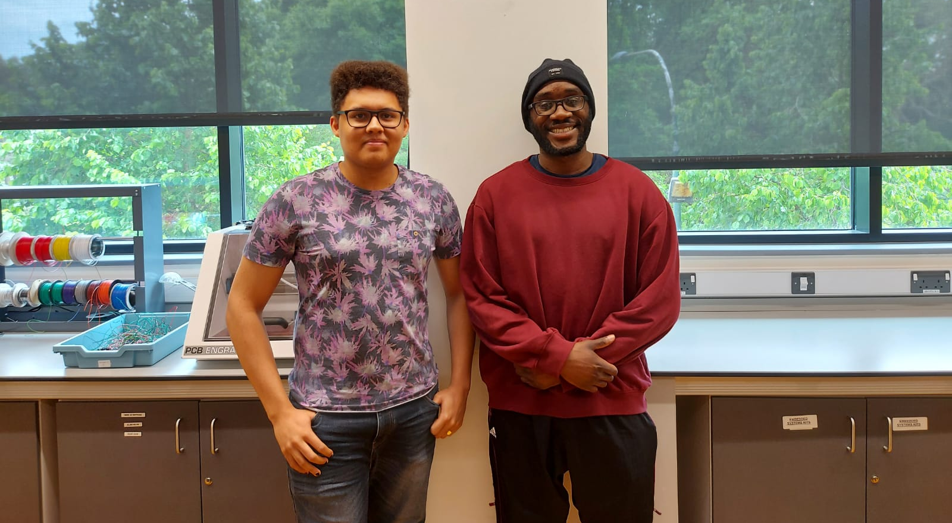
The Team

Slide 5
Extra Details

Slide 6
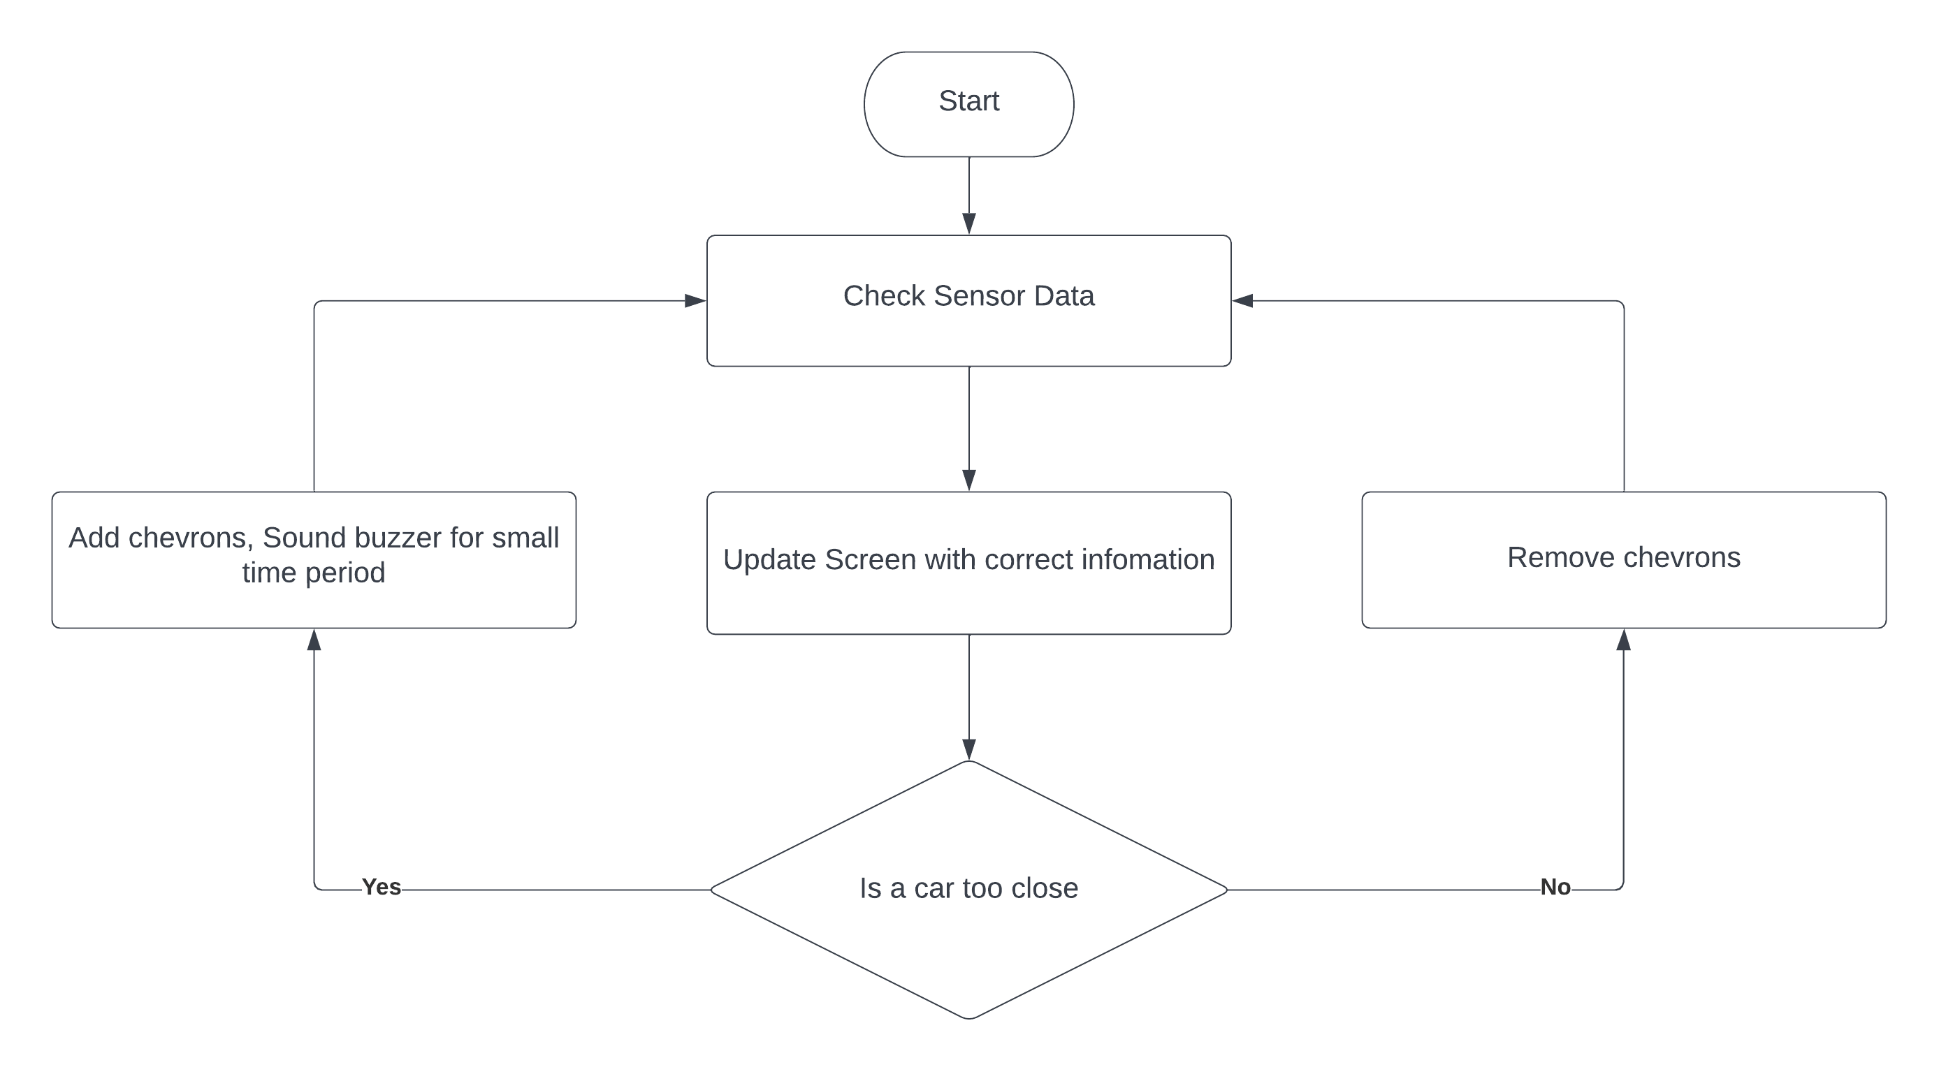
RTOS Flow

Slide 7
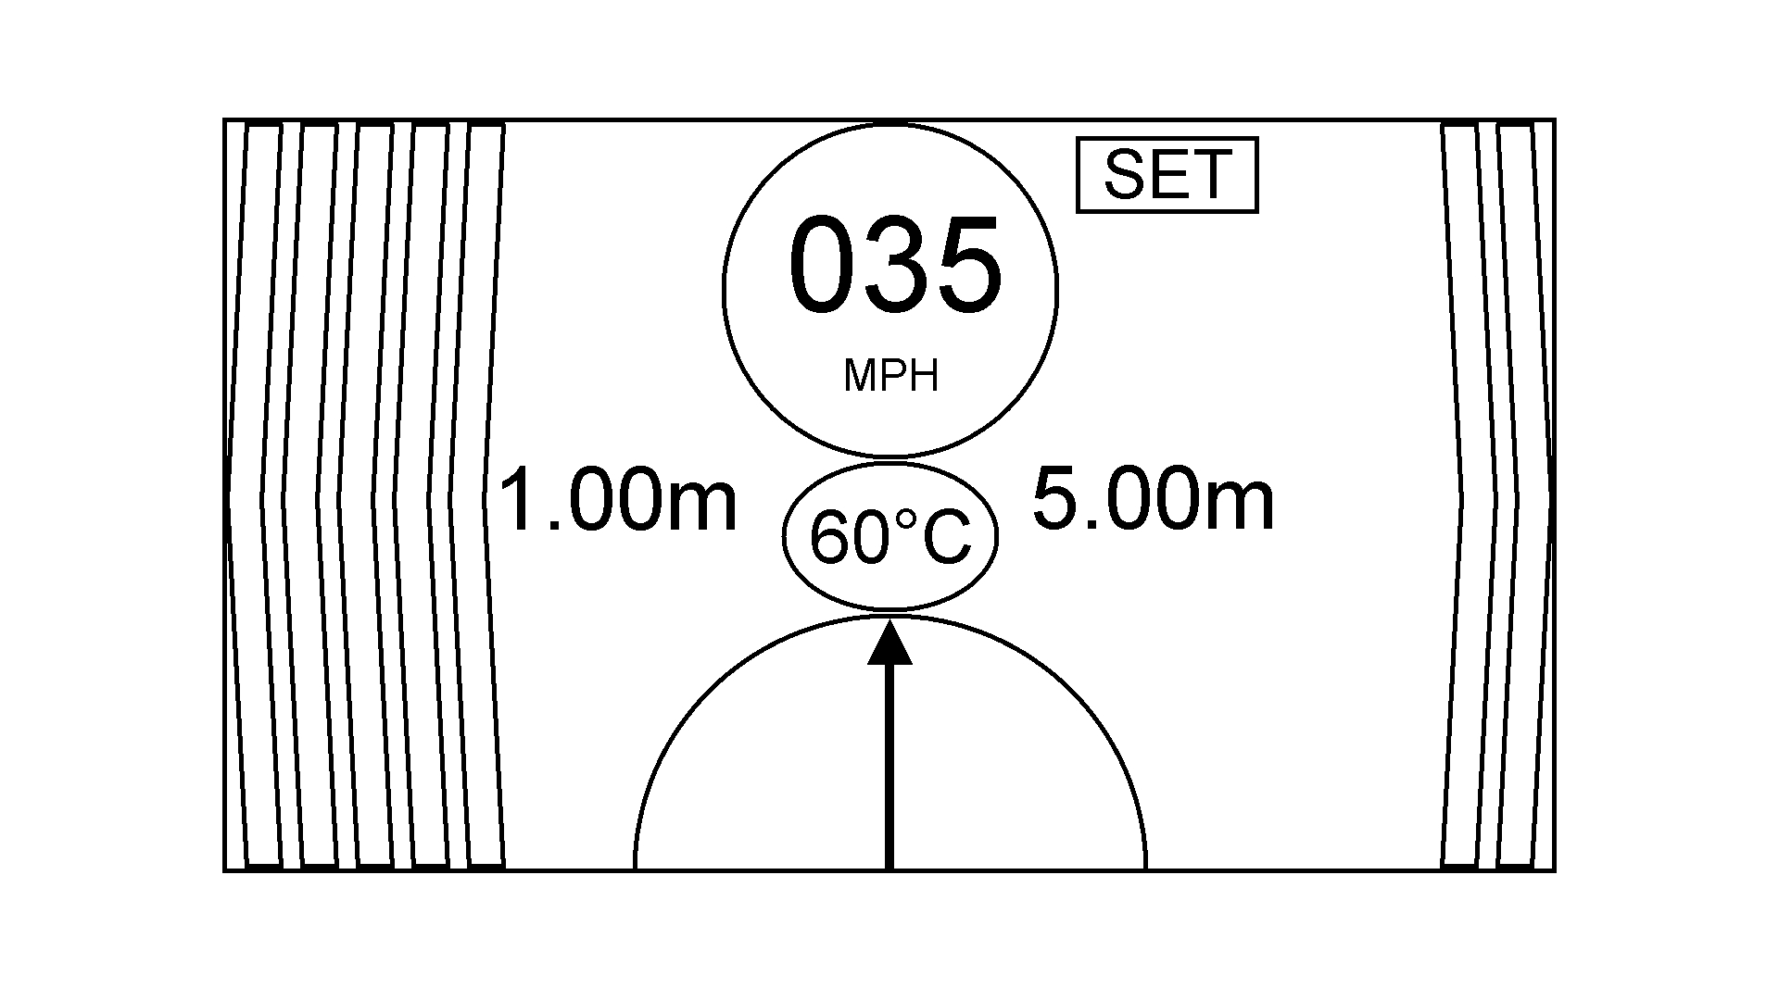
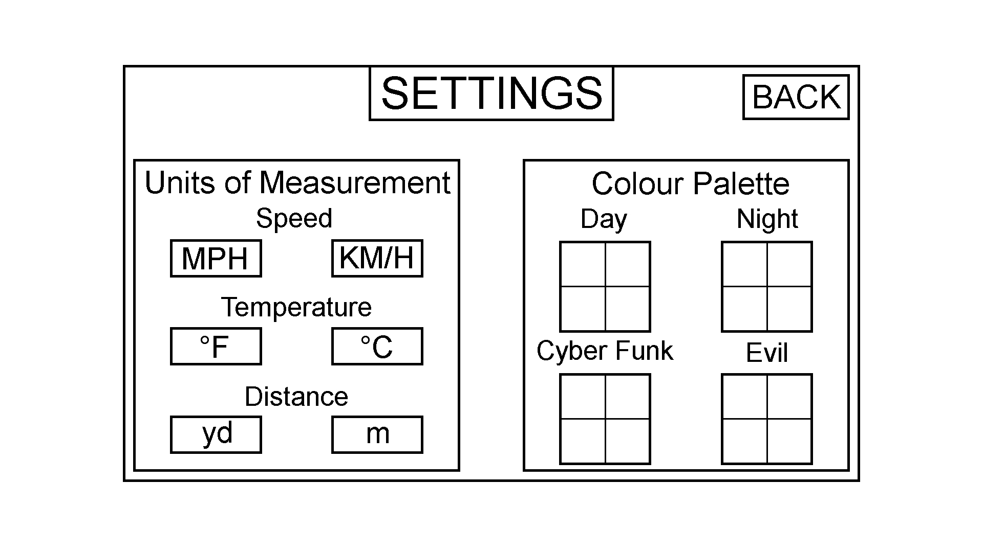
UI Design
Important information needs to be large and bold.
Minimal buttons on the main screen
Colour and unit options

Slide 8
Peripheral Usage
MPU 6050
Returns Pitch, Roll and Yaw
Used to get an angle of rotation
Ultrasound Sensor
Returns travel time
Distance from object can be calculated
Temperature Sensor
Returns digital temperature reading
Rotary encoder
Returns two clocks and checks which one goes low first.

Slide 9
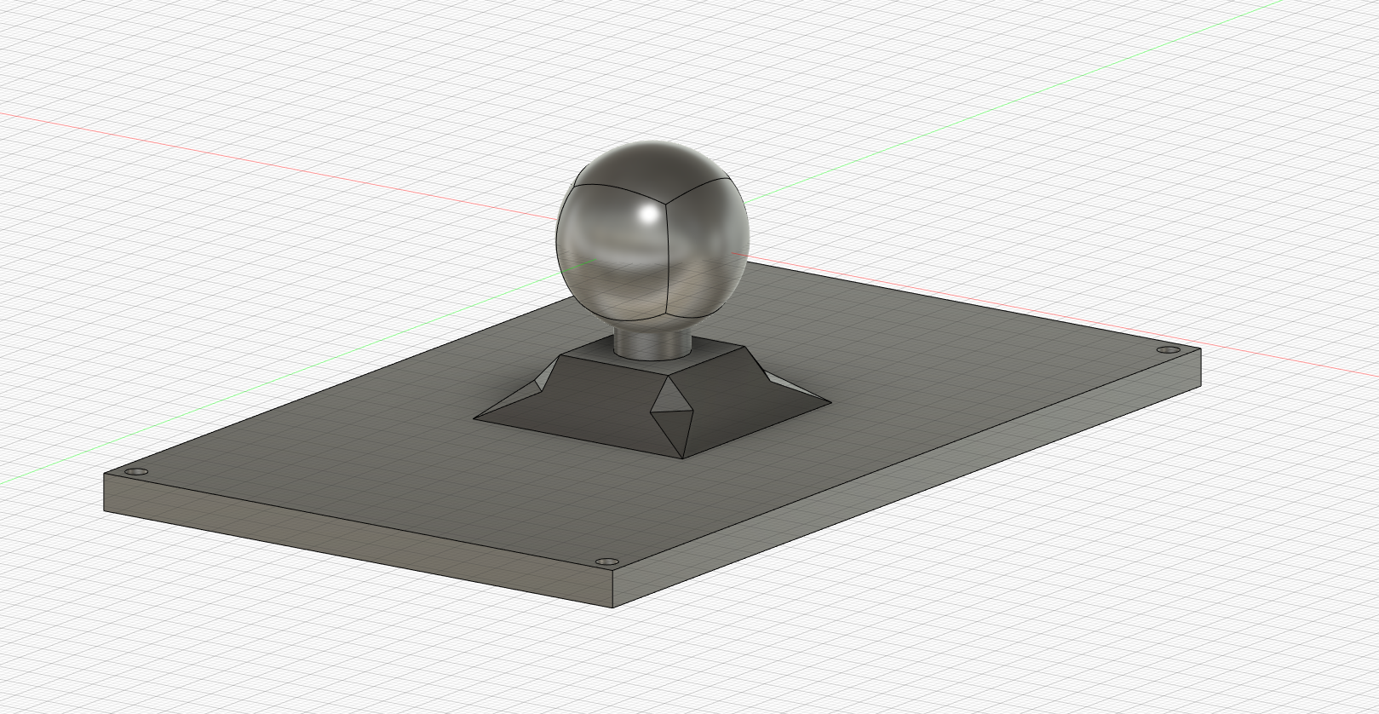
Model Design

Slide 10
Issues
Timers on the STM32F746G Board are inaccurate
Lots of peripherals require nano second delays
Black backgrounds and bright colours can be hard to see in the sun
Needed to use the pro version of uVision to flash the device
To many functions being called in main()

